Slide 1
CPE 133
Review
Comparators
Experiment #5 Overview

Slide 2
Design Problem Example 4
Design a circuit that has two 8-bit unsigned binary inputs A & B. If the sum of A+B is less than 128, the circuit outputs A; otherwise the circuit outputs B. Assume the result of the addition is always valid.
Show top two levels of BBD
State how circuit is controlled

Slide 3
Foundation Modules (thus far)
RCA
Generic Decoder
Standard Decoder
4:1 MUX

Slide 4
Behavioral Models: Process Statements
Behavioral Model
Describe a circuit using statements rather than logic
Once again free from writing Boolean equations
Always blocks
Contain two type of statement
Procedural assignment statements
Procedural programming statement
if-else & case statement

Slide 5
Comparators
Standard digital circuit
Classic & well-known XOR circuit
Easy HDL behavioral modeling
Design a circuit that compares the values of two 2-bit inputs and indicates when the input values are equal

Slide 6
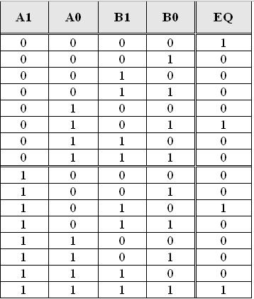
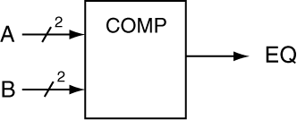
Design for 2-Bit Comparator
Implied “unsigned binary”

Slide 7
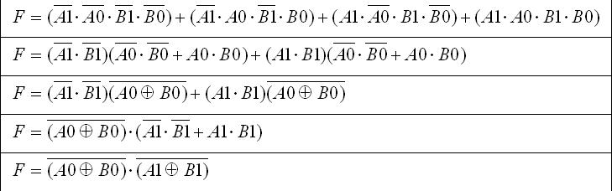
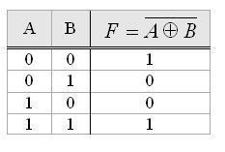
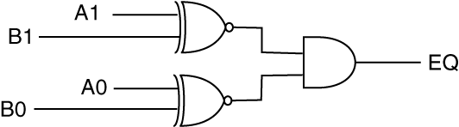
PPT Design
The classic “equivalence gate” (XNOR)

Slide 8
10-Bit Comparator Verilog Model
module comp_10(a, b, eq, lt, gt);
input [9:0] a,b;
output reg eq, lt, gt;
always @ (a,b)
begin
if (a == b)
begin
eq = 1; lt = 0; gt = 0;
end
else if (a > b)
begin
eq = 0; lt = 0; gt = 1;
end
else if (a < b)
begin
eq = 0; lt = 1; gt = 0;
end
else
begin
eq = 0; lt = 0; gt = 0;
end
end //- always
endmodule

Slide 9
n-Bit Comparator Verilog Model
module comp_nb(a, b, eq, lt, gt);
input [n-1:0] a, b;
output reg eq, lt, gt;
//- default input data width
parameter n = 8;
always @ (a,b)
begin
if (a == b)
begin
eq = 1; lt = 0; gt = 0;
end
else if (a > b)
begin
eq = 0; lt = 0; gt = 1;
end
else if (a < b)
begin
eq = 0; lt = 1; gt = 0;
end
else
begin
eq = 0; lt = 0; gt = 0;
end
end
endmodule

Slide 10
Comparator Foundation Modules
Comparator

Slide 11
Example
Provide a Verilog structural model for a 12-bit comparator by instantiating an 8-bit and a 4-bit comparator using the n-bit comparator model. This comparator only has an EQ output.

Slide 12
Solution
module comp_12b(a, b, eq);
input [11:0] a,b;
output eq;
wire eq4,eq8;
assign eq = eq4 & eq8;
//- instantiate 4-bit comparator
comp_nb #(.n(4)) MY_COMP4 (
.a (a[3:0]),
.b (b[3:0]),
.eq (eq4),
.gt () ,
.lt () );
//- instantiate 8-bit comparator
comp_nb MY_COMP8 (
.a (a[11:4]),
.b (b[11:4]),
.eq (eq8),
.gt (),
.lt () );
endmodule
module comp_nb(a, b, eq, lt, gt);
input [n-1:0] a, b;
output reg eq, lt, gt;
//- default input data width
parameter n = 8;
always @ (a,b)
begin
if (a == b)
begin
eq = 1; lt = 0; gt = 0;
end
else if (a > b)
begin
eq = 0; lt = 0; gt = 1;
end
else if (a < b)
begin
eq = 0; lt = 1; gt = 0;
end
else
begin
eq = 0; lt = 0; gt = 0;
end
end
endmodule

Slide 13
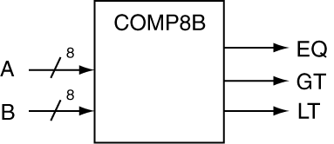

Experiment 5: 8-bit Comparator with using Structural Modeling
Construct 8-bit Comparator using two 4-bit comparators
Not efficient, but good structural model practice
Final model: two 4-bit comparators with some “extra logic” to handle EQ, GT, & LT
Use provided comparator template
Top-level Model
Lower-level Module

Slide 14
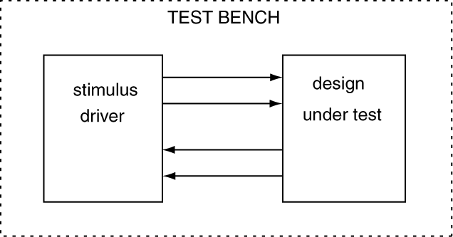
Verilog Testbenches
Verilog model that tests your model by providing test data inputs
Not my strong point (use cheatsheet)
Test data = test vectors
DUT = device under test
Call someone over to show you basic operation of simulator

Slide 15
Testbench Overview
Stimulus driver provide test vector input to DUT
Testbench model has no inputs or outputs

Slide 16
Testbench for 4-bit Comparator
module tb_comp_4b( );
//- stimulus connections to DUT
reg [3:0] a, b; //- stimulus outputs
wire eq, lt, gt; //- DUT outputs
//- DUT instantiation
comp_4b MY_COMP (
.a (a),
.b (b),
.eq (eq),
.lt (lt),
.gt (gt) );
initial
begin
//- initial values of a & b
a = 'hA;
b = 'hB;
//- a & b values 20 time units later
#20 a = 'hB;
b = 'hB;
//- a & b values 20 time units later
#20 a = 4'b1011;
b = 4'b0001;
//- a & b values 20 time units later
#20 a = 4'b0001;
b = 4'b0001;
end
endmodule
module comp_4b(a, b, eq, lt, gt);
input [3:0] a,b;
output reg eq, lt, gt;
always @ (a,b)
begin
if (a == b)
begin
eq = 1; lt = 0; gt = 0;
end
else if (a > b)
begin
eq = 0; lt = 0; gt = 1;
end
else if (a < b)
begin
eq = 0; lt = 1; gt = 0; end
else
begin
eq = 0; lt = 0; gt = 0;
end
end
endmodule

Slide 17
Foundation Modules (thus far)
RCA
Comparator
Generic Decoder
Standard Decoder
4:1 MUX

Slide 18
Design Example 1:
Design a circuit that compares three 10-bit unsigned binary values. If all three 10-bit values are equivalent, the EQ3 output of the circuit will be a ‘1’, otherwise it will be a ‘0’.
Provide two levels of BBDs
State how circuit is controlled

Slide 19
Design Example #2
Design a circuit that has two unsigned binary 8-bit inputs and two 8-bit unsigned binary outputs HI & LO. The circuit outputs the greater of the two inputs values to the HI output and the other value to the low input.
Provide two levels of BBDs
State how circuit is controlled

Slide 20
Design Example #3:
Design a circuit that has two 8-bit unsigned binary inputs A and B, and one 8-bit unsigned binary output F1. The greater of two input values appears on the outputs. Output either input value if the numbers are equivalent.
Provide two levels of BBDs
State how circuit is controlled

Slide 21
Design Example #4
Design a circuit that has two unsigned binary 8-bit inputs and two 8-bit unsigned binary outputs X & Y. If a button is pressed, the circuit sorts in descending order (X=hi, Y=lo); otherwise the circuit sorts in ascending order (X=lo, Y=hi).
Provide two levels of BBDs
State how circuit is controlled

